Slide 1


Slide 2

OFFENSIVE
- VS -
DEFENSIVE

Slide 3
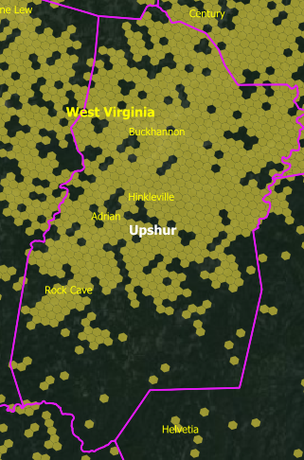
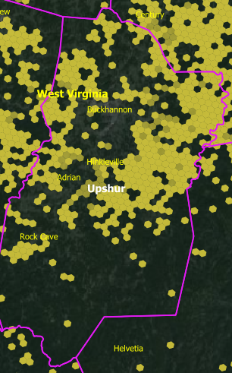
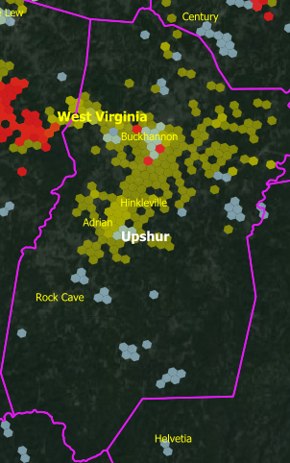
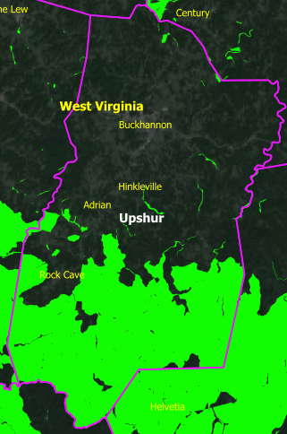
Winncom HEX Mapping Capabilities
Unserved / Underserved Mapping
Project Areas (80% Rule)
Existing Technology: Fiber, CBRS, DSL, Cable
Previous RDOF Funding

Slide 4


FWA 24 GHz / 28 GHz Overview
Semi-rural
Suburban
Optimal point architecture: Serving efficiently dense areas up to 480 subscribers per Base Station site, at extended range up to 6+ Miles

Slide 5
WiBAS FWA – our approach
Future proof solution → Long term performance predictability
        LoS Technology
        Licensed spectrum
        Simplicity (L2 architecture - coreless)
        Coexisting with 5G (where applicable)

Slide 6
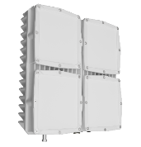



WiBAS™ - 24GHz / 28GHGz Technology Overview
Interference Free Networking
Licensed Spectrum
24.25-29.50 GHz
High Subscriber Density:
up to 120 TS per sector
QoS enabled services: Advanced Ethernet networking features and 2-stage hierarchical QoS
Simple Installation
Compact All Outdoor Units
High Performance
Up to 5 Gbps per sector (TDD)
Optimized network deployment:
Integrated PtMP planning and capacity analysis tools
Hitless Adaptive Modulation
up to 1024 QAM
ZTP automated procedures:
Auto entry / auto authentication / auto provisioning
Long Range Links
up to 6 miles (1Gbps ~2miles)
Lifecycle management:
Powerful centralized Management (UniMS)
Intracom Telecom Confidential
6
Intracom Telecom Confidential

Slide 7
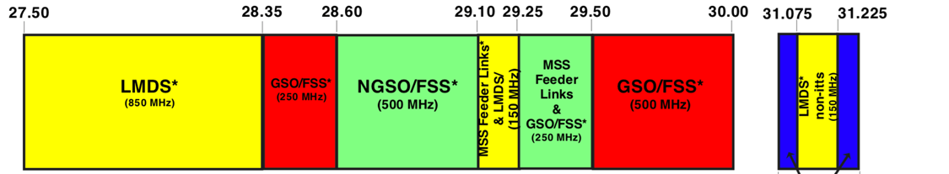
WiBAS Frequency of Operation
24/26/28 GHz-TDD Evo-BS | Frequency Range (MHz) | 24,250 – 29,500
 | TDD Split Options | 4:1 / 3:2
 | Channel Sizes (MHz) | 40/50/100/200
 | Supported Bands | 3
 | Lower | 24,250 to 26,500
 | Mid | 26,500 to 28,500
 | Upper | 27,500 to 29,500
FCC 28GHz assignment
(“LMDS” term as per previous FCC terminology. Current term is “UMFUS”)

Slide 8
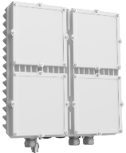





WiBAS™ G5 - Base Station variants
TDD
24.25-29.50 GHz
26.5-28.50 GHz 4x4 MU-MIMO
Beamforming
FCC certified
40 /50 /100 MHz
800Mbps
100/200 MHz
5 Gbps

Slide 9

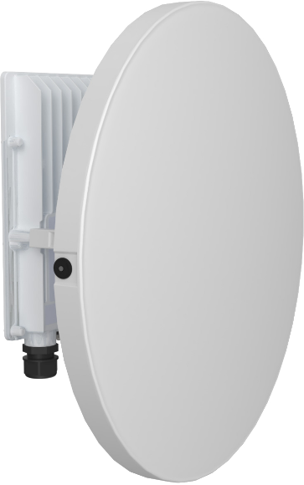






WiBAS™ G5 - Terminal Station Variants
TDD
24.25-29.50 GHz
26.5-28.50 GHz
40 / 50/ 100MHz
0.8 Gbps
100 / 200 MHz
1 Gbps

Slide 10

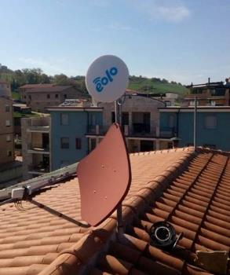

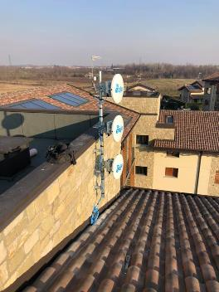
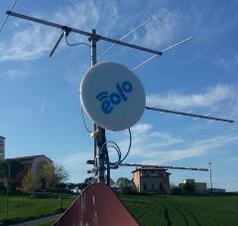
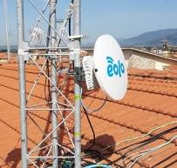



WiBAS™ purpose-built FWA, delivering excellence in EOLO
Italy
The largest mmWave FWA network worldwide
Licensed 28GHz spectrum
Ultra broadband, fibre-like services with QoS
Extended Coverage, addressing rural, semi-rural & sub-urban
Dense network of several 100s of terminals per Base Station
Massive nationwide network rollout
Reliable Wireless backhauling with UltraLink™ E-Band radios

Slide 11


Reliable solution proven worldwide
  >50 networks worldwide
Base Station Hubs 18,000
FWA Terminals
500,000
Accumulated expertise & know how for 20 years
Intracom Telecom Confidential

Slide 12
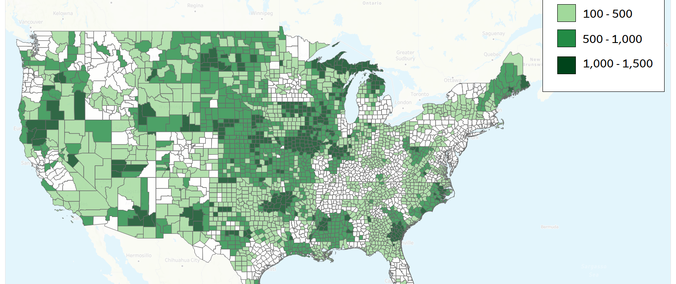
Nationwide 24/28 GHz Availability

Slide 13

State of Microwave links today
      The network
      High utilization rates in existing links with little space left for growth
      The service
      Reduced or downtime on services during peak demand
      Regulator trend
      Scarcity of spectrum → Push for increased efficiency (XPIC)

Slide 14


Ultralink-GX80: Highest system gain in market @10Gbps
OpEx savings
Longer link distances
More robust links during weather anomalies
→ Capacity will be more stable
Better link reliability
→ Link will be active longer
CapEx savings
One or both sides of the link may have the same performance with smaller antennas
→ Smaller rental space on the tower
Easier alignment
Better stability on poles
70.6 dB
@10Gbps

Slide 15
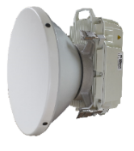


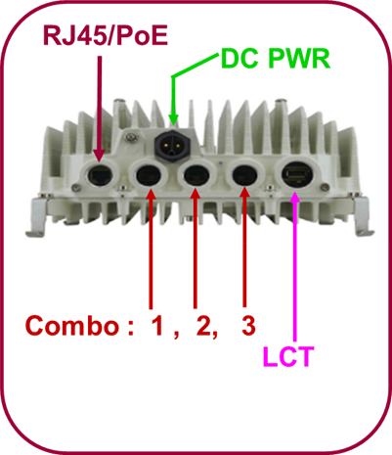
UltraLinkTM-GX80 - Functionality highlights
  Operates in 71-76/81-86GHz
  125 / 250 / 500 / 750 /1000 / 1500 / 2000MHz
  1+0, 2+0 XPIC*, 2+0XPIC/RLA*, Dual Band* with Intracom Telecom and 3rd party MW radios
  Modulation 4QAM up to 1024QAM(depending on channel size), HACM, ATPC
  Ethernet L1 capacity up to 10 Gbps @ 1.5GHz & 2GHz
  Highest System Gain @ 10Gbps @2000MHz/128QAM
  exceeds 70dB (Enhanced power operation*)
  Integrated Ethernet Networking functionality (IEEE 802.1Q / 802.1ad), Eth. Port LAG/LACP*, Eth Ring Protection G.8032v2*
  OAM : IEEE 802.1ag (CFM)*, BNM&CSF*, G.8013/Y.1731 – Performance Monitoring*, IEEE 802.3ah-Link OAM*, LLDP*
  QoS (8 CoS – Ingress Policing – Scheduling - Queue congestion management) & Two-Level Egress HQoS*
  Advanced Packet Synchronization : SyncE, 1588-2008 TC*&T-BC* Class B, ITU-T G.8275.1
  Support of transport of CPRI*, eCPRI
  Integrated Radio Link Monitoring Tool*
*Licensed

Slide 16
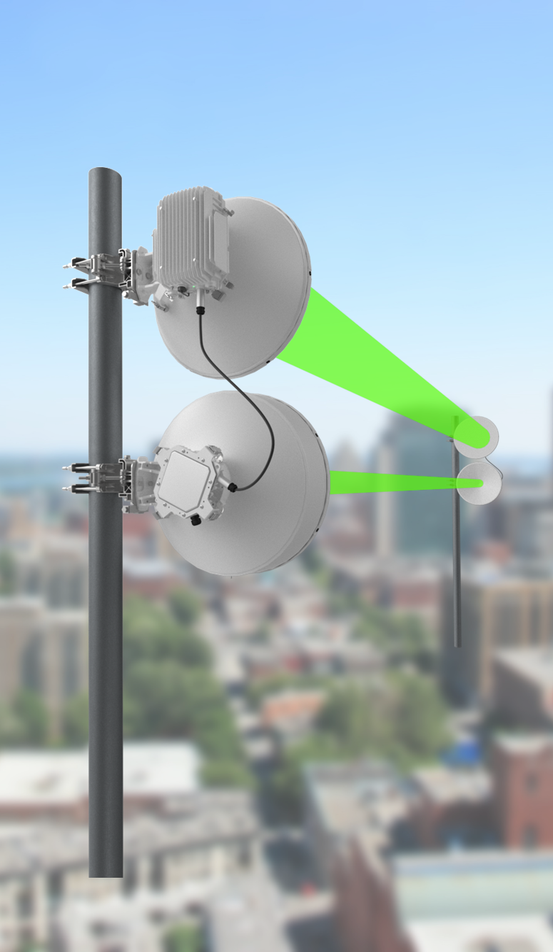


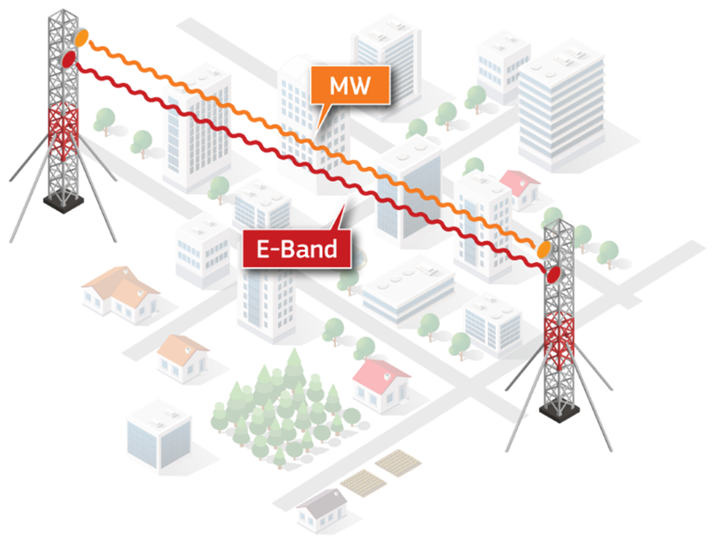
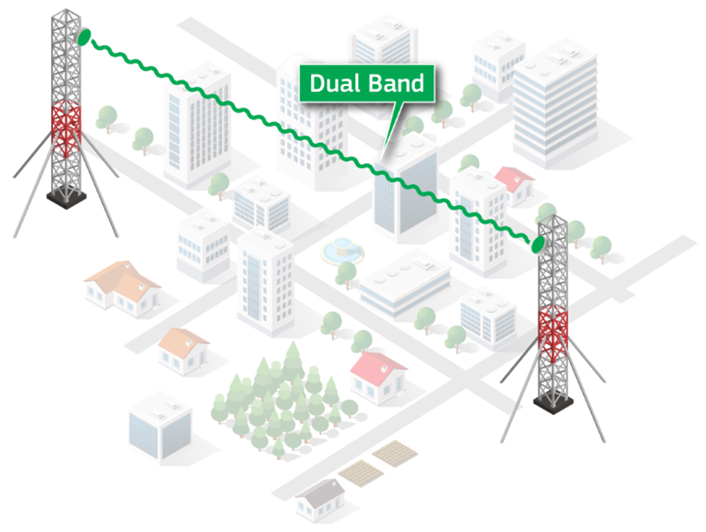

Dual Band solution with 3rd party MW

Slide 17




Slide 18

Winncom Grant Writing Services
Document verification
Application writing
Ensuring document compliance
Use-case analysis and technology alignment
Pre-award educational support
Post-award compliance support
Invoice Reimbursement
Compliance Documentation Reporting
Notes:
Winncom’ s Grant Writing Service will provide project management throughout the grant application process. We will check every document and assist with any questions along with post award
compliance support.
Post-award support:
Government funding requires ongoing accountability. To make that easier, we offer post-award support. To ensure taxpayer dollars are well spent, the government requires strict compliance requirements durning the project. This includes:
Progress and closeout reports.
Documentation of work performed and how the funds are spent.
Reimbursement invoices and quote submissions.
Our support program includes”: compliance consulting, performance reporting, invoice reimbursement, and closeout reporting.

Slide 19

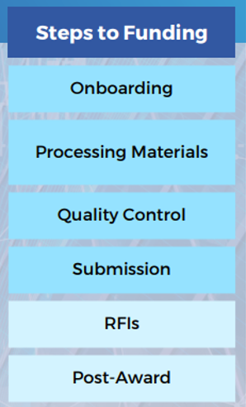
Timeline Estimates
Overall Project Deadlines:
Standard minimal time: 6-8 weeks.
Expedited minimal time: 30-days
Estimated Project Timelines:
Onboarding: 3-5 business days
Processing application materials: 2-6 weeks
Quality control: 1-2 weeks
Application submission: 1-3 days
RFI support: 2-4 weeks (Optional Service)
Post-award compliance services: From 2-3 weeks up to several years (Optional Service)
Notes:
Post support is required. Through our grant writing service, you will have a dedicated contact and a proven workflow that will take you through processing the materials to project reimbursements.

Slide 20


Slide 21

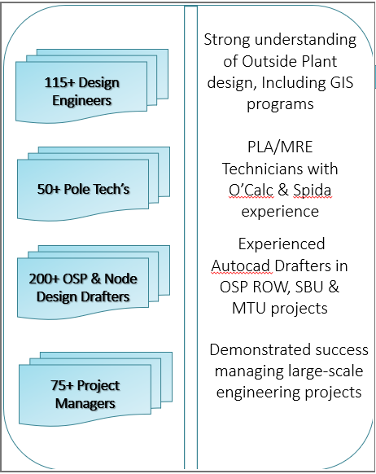



WINNCOM PROFESSIONAL ENGINEERING SERVICE
Winncom Professional Engineering Service
Network Design
&
Optimization
PMO
&
Compliance Services
Broadband & Fiber
Staffing
&
Strategic Consulting
PORTFOLIO OF
In-Building Services
&
Venue Engineering
SERVICES
Network Testing
&
Verification
Site Commissioning
&
Integration
Notes:
In addition to our native technical support capabilities based on the scope of work and size of these opportunities we have extended our staff through strategic partnerships.
Winncom’s Professional Engineering Service develop engineering plans and exhibits using Civil 3D, AutoCAD and GIS formats.
Offer onsite site surveys for wireless and fiber systems and provide PE stamped drawings.
Through our service, we have the ability to manage your OSP construction projects.
Our professional service provider has over 40-years in experience. Typical projects include:
AS-build projects: scope includes locating existing fiber
Relocation Projects: Relocation of existing plant. Scope includes fielding, excavation permits, new design, and traffic control designs.
Network Drop Projects: Field, sesign, engineering, and permit design.
Backhaul Engineering: Full engineering design of fiber runs
FTTE Projects: Field, engineering & permit drawings
FTTH Projects: Scope included the design, engineering (fiber counts and splice types) of fiber runs via Aerial and Underground to homes

Slide 22
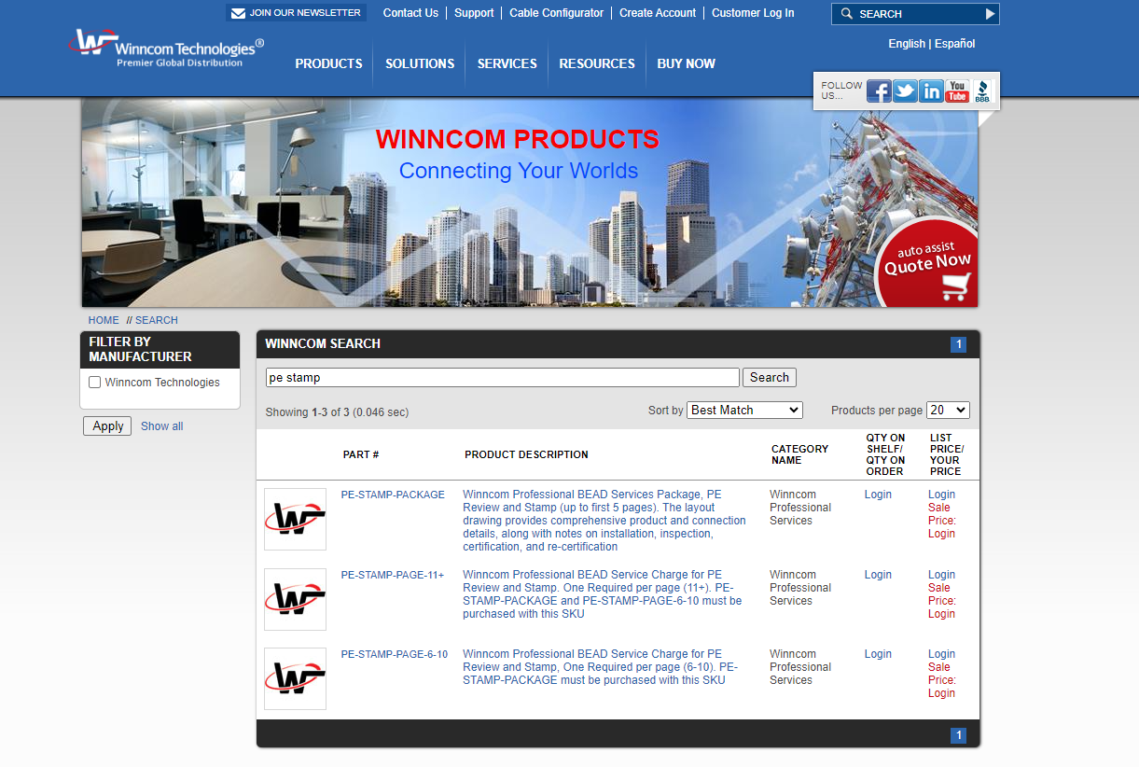

Slide 23


Financing Solutions: Tailored financing options for both services and equipment, enabling project execution without upfront capital constraints.
Comprehensive Support: From project inception to completion, our financial services are designed to empower applicants, ensuring compliance and enhancing project viability.
Notes:
We are partnered with LEAF, a leading provider in tailored financial solutions, specializing in empowering BEAD program participants with essential funding support for services and equipment.
Funding is a potential problem. It is possible to need up to 50% coverage. 25% letter of credit plus 25% grant match
With leaf, we can offer you two different types of options.
Leaf Financial Corporation was formed in 2002. Operating over 22 years, Leaf is also a part of Bank of America.
Capital Now Program. This is a leasing service for nontangible products like grant writing and professional engineering. Like working capital, this short-term financing options provides up to 300K in funds financed over a 3–24-month term. 25,000 minimum to $300,000 maximum
Equipment Financing Options. Reduce your grant match obligation by prepaying for equipment. This is leafs bread and butter. Longer term financing. UP to 1-5 years. Preapprovals available up to 500k.

Slide 24

Winncom BEAD Portal

Slide 25

Action Items:
Schedule a consultation to strategize on positioning your company for a successful BEAD application in your state
Schedule a call to learn more about Winncom BEAD Programs
Schedule a call to learn more about Intracom Telecom
Contact Information
Winncom Bead Consultation: bead@winncom.com
George Harlaftis: gharlaftis@conklin-intracom.com
Winncom BEAD Portal
Registration Link: www.winncomus.com/bead/

Slide 26


Slide 27


