Slide 1
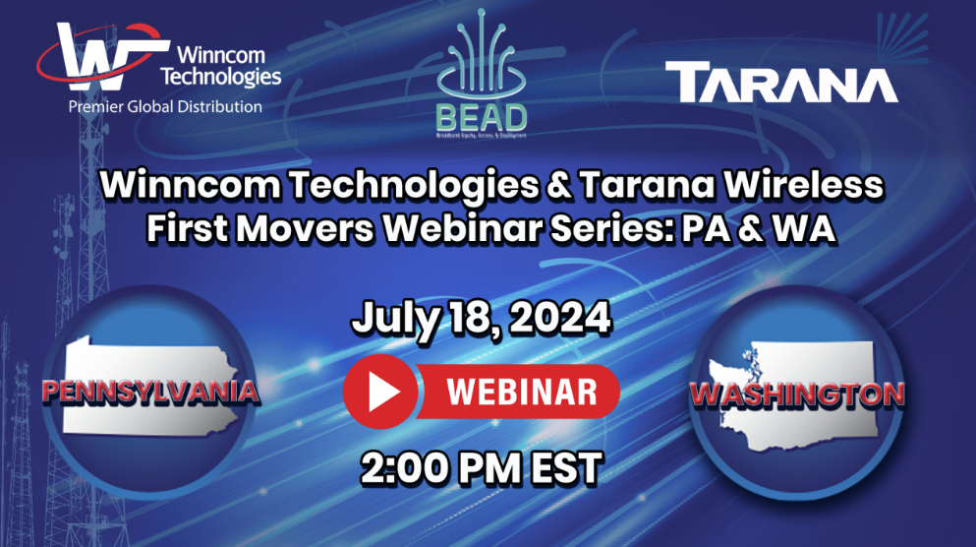


Slide 2

WEBINAR’S AGENDA
TARANA WIRELESS
State Funding Profiles (PA / WA)
Pre-Application Process Overview
Live Tech Demos Review
Timelines / Scoring System / Eligible Technology
WINNCOM’S BEAD STATEGY
Winncom BEAD Product Strategy Review
Winncom Value-Added Services:
Winncom Enhanced Services
Grant Writing
Professional Engineering Services
Financial Services
QGIS Network Design Tool
High Level Fiber Design

Slide 3



First Movers Webinar: Pennsylvania and Washington
July 2024

Slide 4
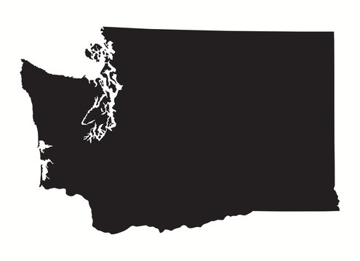

Why Washington and Pennsylvania?
Billion-dollar BEAD states
  Washington $1.2 billion
  Pennsylvania $1.16 billion
Challenging topography and population densities that necessitates use of non-fiber broadband technologies.
Washington SBO will allow providers to submit project bids using multiple technologies (fiber + licensed fixed wireless, etc.)
Strong IP Volume 2’s with early NTIA approval

Slide 5
BEAD Process for Washington and Pennsylvania
Washington →
Vol. II approved on May 9, 2024
Challenge Process Final Determination (8/3)
No preapplication process
BEAD application
  Round 1 Application (60 days)
  Round 1 Application Review (30 days)
  Round 2 Application (60 days)*
  Round 2 Application Review (30 days)*
  Direct engagement (60 days)*
  Draft awards (30 days)
Pennsylvania →
Vol. II approved on May 6, 2024
Challenge Process Complete (5/23)
Preapplication process
BEAD application – October/November
  Round 1 Application (60 Days)
  Round 1 Application Review (49 Days)
  Round 2 Application (60 Days)
  Round 2 Application Review (60 Days)
  Drafting of the Final Proposal (60 Days)
*If project areas are left over
Notes:
Why haven’t they announced the next steps or timing for preapplication? States are waiting on NTIA for final approval of their

Slide 6

BEAD Preapplication
The preapplication process/prequalification/preregistration process
  Will allow applicants to submit information to demonstrate their eligibility and capacity to compete for grants to expand broadband infrastructure to Target Locations in the state using BEAD funding.
  Meant to streamline the application process and review of proposed projects.
  In some states it is elective, while in others it is mandatory
Tarana Wireless STRONGLY encourages you to begin the process of putting together your BEAD preapplication now.

Slide 7
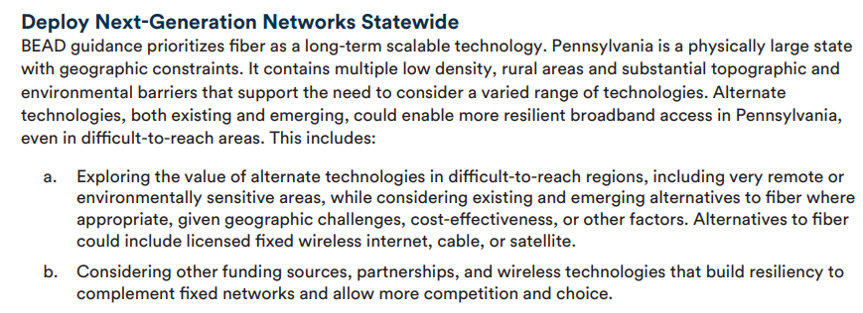
Pennsylvania – Next-Generation Networks
Pennsylvania IP Vol. II (NTIA Approved), pg. 2

Slide 8
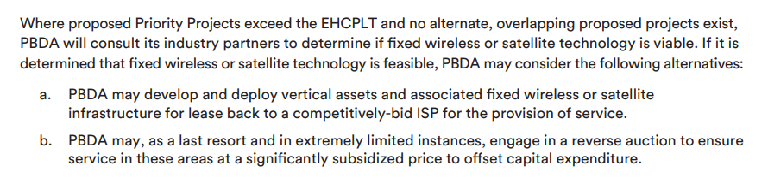
Pennsylvania – Enforcing the EHCPLT
Pennsylvania IP Vol. II (NTIA Approved), pg. 37

Slide 9

Preapplication Process - Pennsylvania
Pennsylvania (90 days)
  Preliminary screening application
    Audited financial information for 3 years prior to application
    Revised PBDA-supplied.csv: Indication of proposed BSLs to be served and (optional) cost to serve each BSL
    Proposed technology
    Proposed speeds
    Proposed monthly subscription cost
    Proposed cost per passing
    Proposed project total cost
    Proposed matching
    Match commitment letter
  Upon conclusion of preliminary screening application review, the PBDA will then authorize successful applicants to submit a final application

Slide 10
Pennsylvania Scoring Criteria – Non-Priority Projects
Minimal BEAD Program Outlay (35 pts)
Affordability (25 pts)
Fair Labor Practices (15 pts)
Speed to Deployment (1 pts)
Speed of Network and Other Technical Capabilities (5 pts)
Equitable Workforce Development and Job Quality (10 pts)
Local Government Coordination (4 pts)
Open Access (5 pts)

Slide 11
Washington Scoring Criteria – Non-Priority Projects (100 pts Max.
Minimal BEAD Program Outlay (40 pts)
Affordability (20 pts)
Fair Labor Practices (15 pts)
Speed to Deployment (1 pts)
Open Access (7 pts)
Local and Tribal Coordination (7 pts)
Adoption and Digital Navigation (7 pts)
Speed of Network (3 pts)

Slide 12
Washington Scoring Criteria – Hybrid Technology Project Bids
“The WSBO will still accept applications that propose a combination of fiber optic technology, hybrid fiber coaxial DOCSIS 3.1 or higher, wireless using licensed spectrum, or LEO satellite to serve a project area optimally.” (WA IP Vol. 2, pg. 45)
Applications with multiple technologies for service will be considered for an award in they:
  Satisfy the speed of service requirements.
  Can attain a lower cost per location within the applied project area(s) due to combination of technologies
To be scored using the “Other Last-Mile Broadband Deployment” project scoring criteria
Multiple technology bids will obtain “Speed of Network” scores based on the slowest broadband speed.

Slide 13
Considering ngFWA for your BEAD strategy
Both Washington and Pennsylvania are explicit about the scoring of hybrid technology bids.
For states with multiple rounds of bidding, alternate technology providers should look to feasibly bid all unbid project areas or clusters of BSLs.
Design project bids that exceed the 100/20 Mbps speed standard to demonstrate futureproof and scalable broadband infrastructure.
Depending on the state, this approach will max out the “Speed of network or other technical capabilities” scoring segment and offer valuable application points for non-fiber applicants.

Slide 14
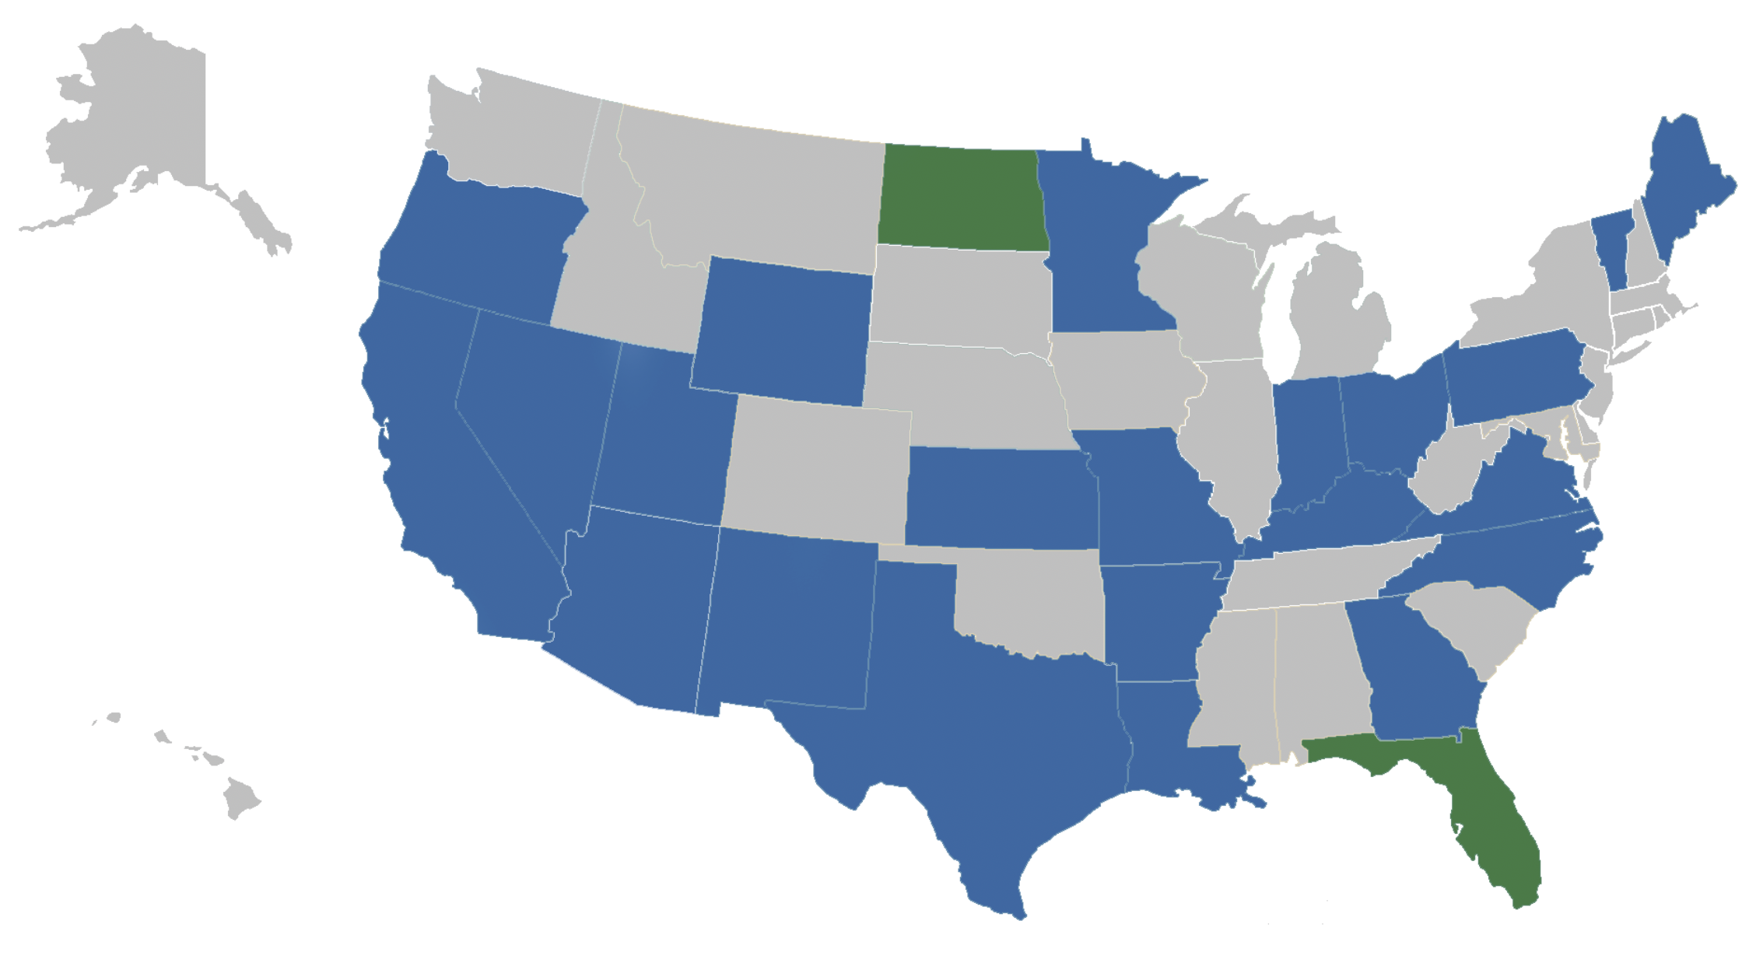
Our Engagement with SBOs has been extensive and productive
KEY
Blue = In-state tour with SBO successfully completed (22 Completed)
Green = In-state tour with SBO scheduled & coming (2 scheduled)
Notes:
Assistant Secretary Davidson, BEAD Director Evan Feinman,
Nearly 50 live technology demonstrations in 24 states.

Slide 15
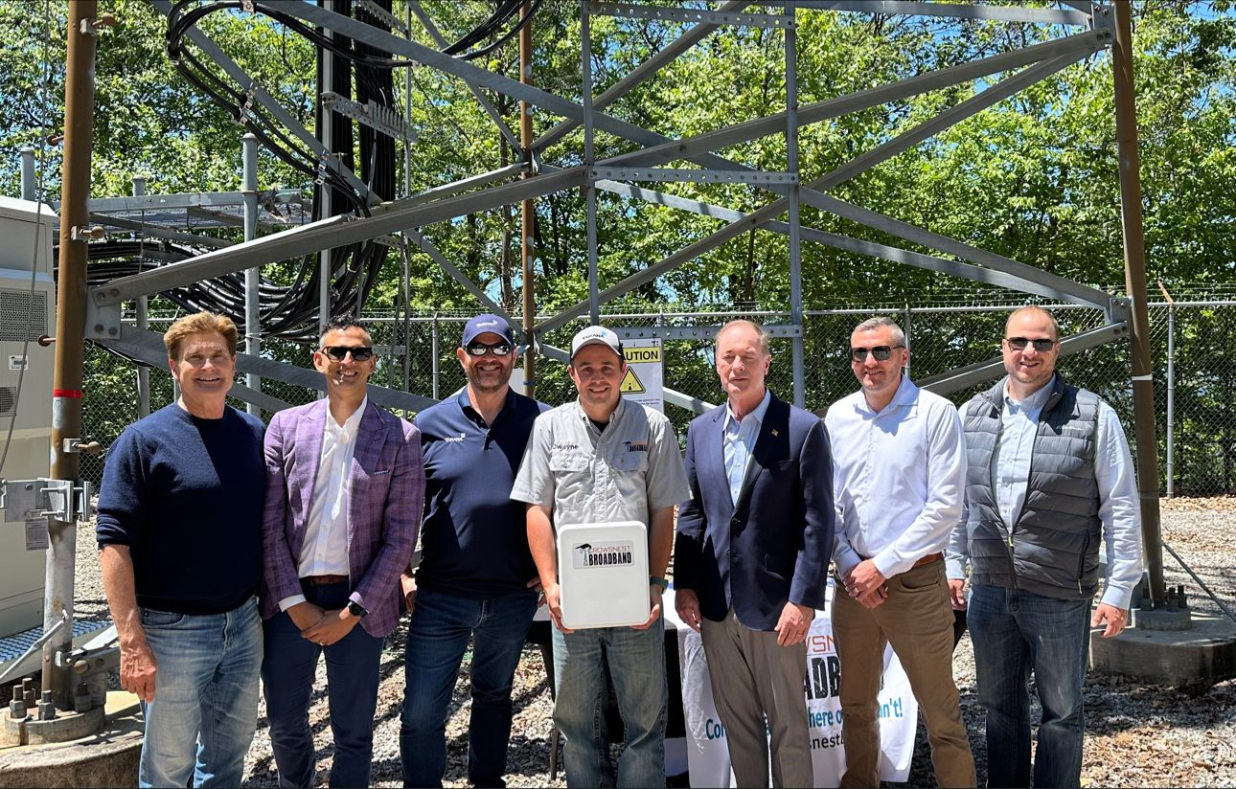
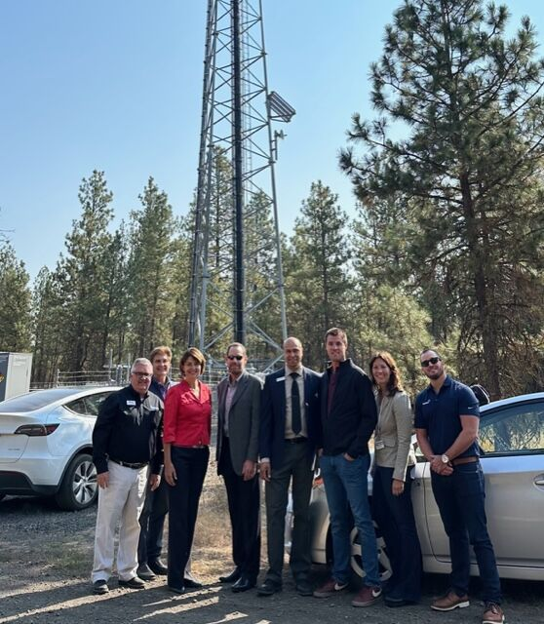
Live Tech Demos: Washington & Pennsylvania
Brandon Carson and Brandon Peters
Pennsylvania Broadband Development Authority
Rep. John Joyce (PA-13)
House Energy and Commerce Committee
Rural Broadband Caucus
Rep. Cathy McMorris Rodgers (WA-05)
Chair House Energy Commerce Committee

Slide 16


Winncom BEAD Strategy & Services

Slide 17

Identify
Plan
Apply
Receive
Procure
Construct
Operate
Winncom Customer Strategy
Products
Services
Financing
Notes:
Robust Team of experience professionals
Turnkey Experience. Single Point of Contact through your account manager.

Slide 18

Network Planning
&
Design
QGIS Mapping Eligibility

Slide 19
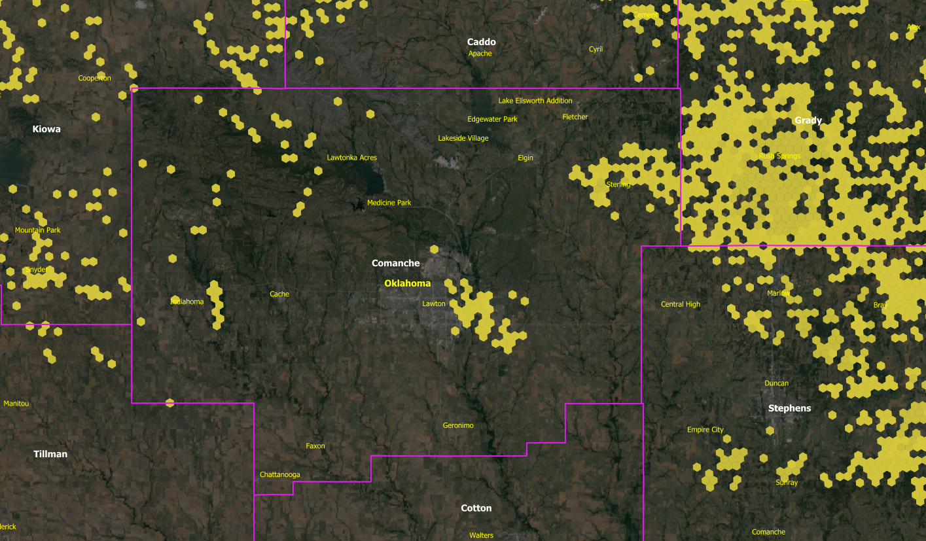
Notes:
Winncom leverages a proprietary QGIS data tool.

Slide 20
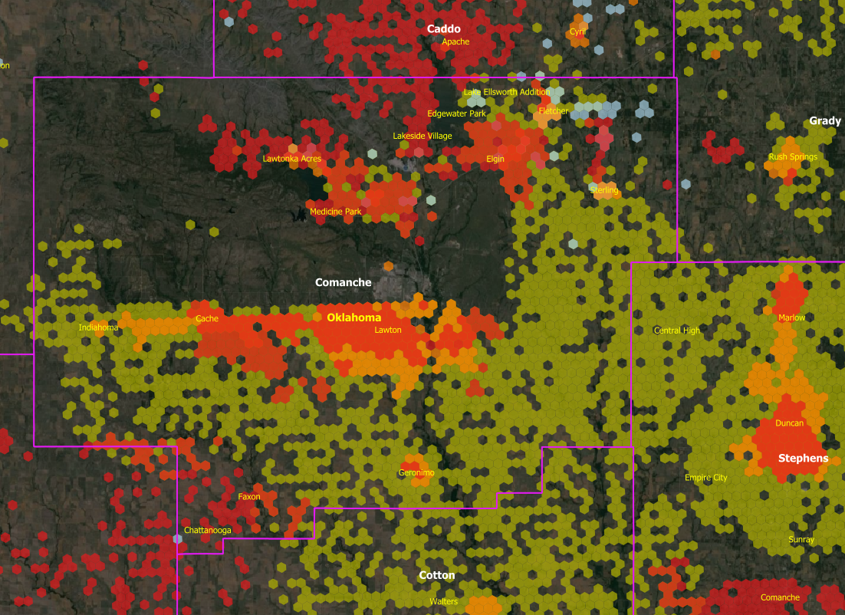

Exist Technology

Slide 21
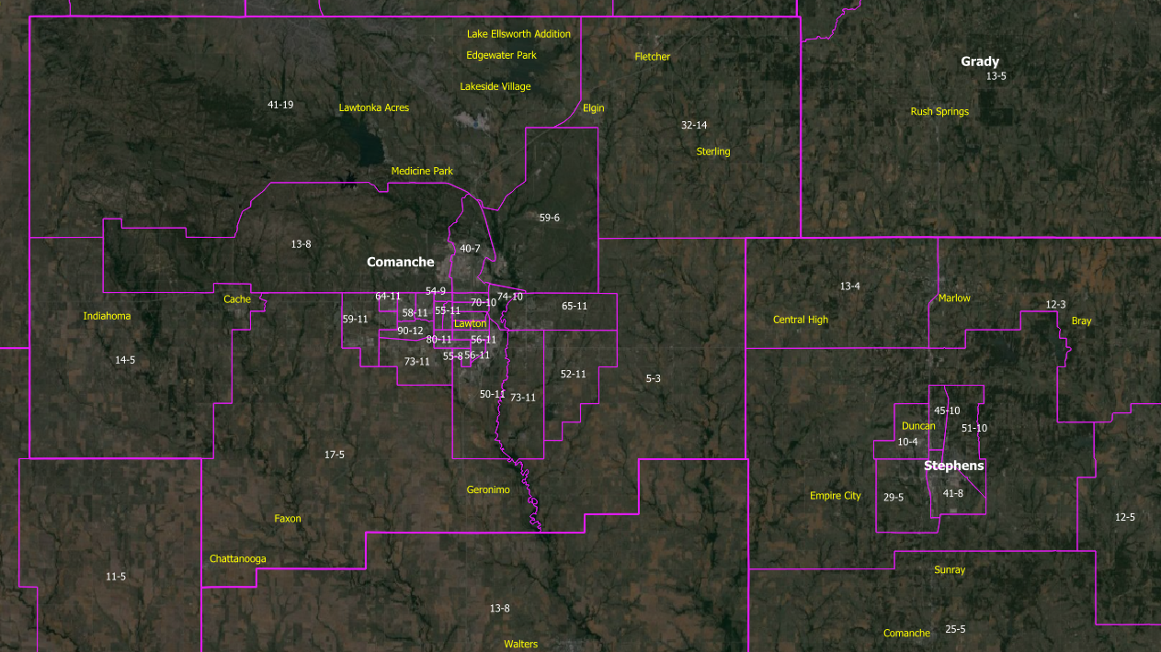
Ookla Qualifying Broadband Speeds

Slide 22
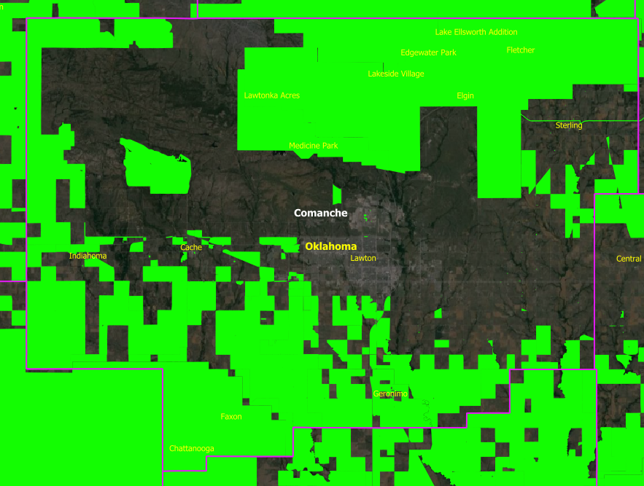
Previous Government Funding
EACACM
RUS: Rural EConnectivity Program
CAF II
RDOF

Slide 23
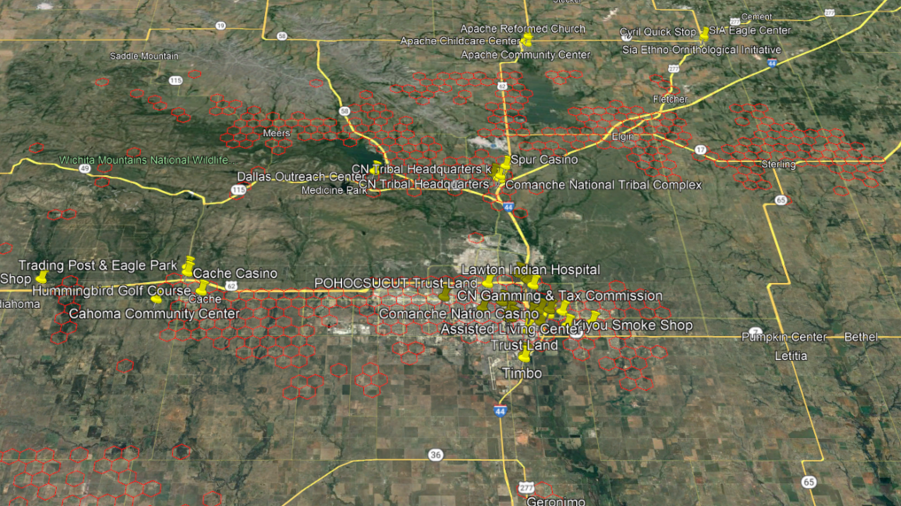

Slide 24

Winncom Enhanced Services
High Level Fiber Design
Grant Writing
Professional Engineering Services
Financial Services

Slide 25
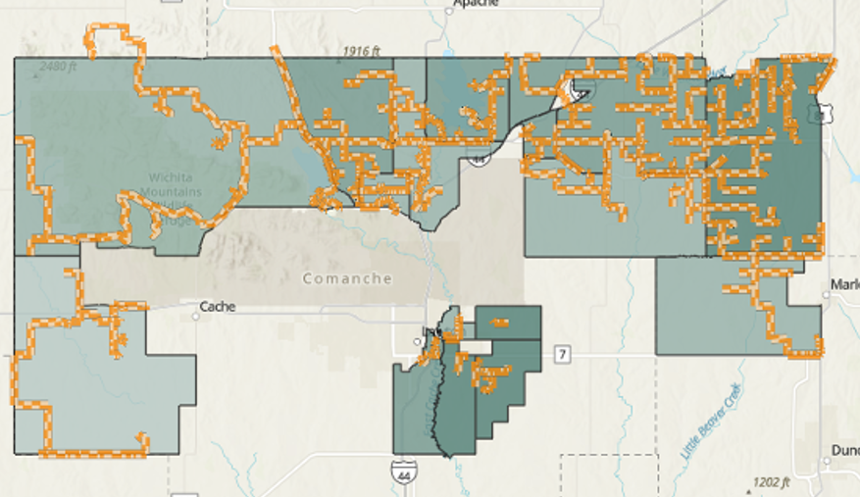
Enhanced Services: High-Level Fiber Design

Slide 26
WHERE, WHAT and HOW MUCH To Bid?
You provide us a few parameters…and we will provide the WHERE to bid, the recommended network structure (WHAT) with the costs and ROI (HOW MUCH)
THE WHERE
Comparative ROI Ranking
Competitive Breakdown
THE NETWORK
AI Generated Fiber Spine
Soil/Terrain Complexity
THE MONEY
10 Year Pro-Forma:
OPEX/CAPEX
Adoption Rate & Build by Phase Revenue
Build Phases
Number and Cost for High-Cost Locations
Identified Unserved/Underserved (Housetop)
Customized Buried/Aerial costs
Demographics of Project Bid Area
Historical Federal Grant Winning Locations
Stage Grant Funds
Winning Bid Recommendation

Slide 27
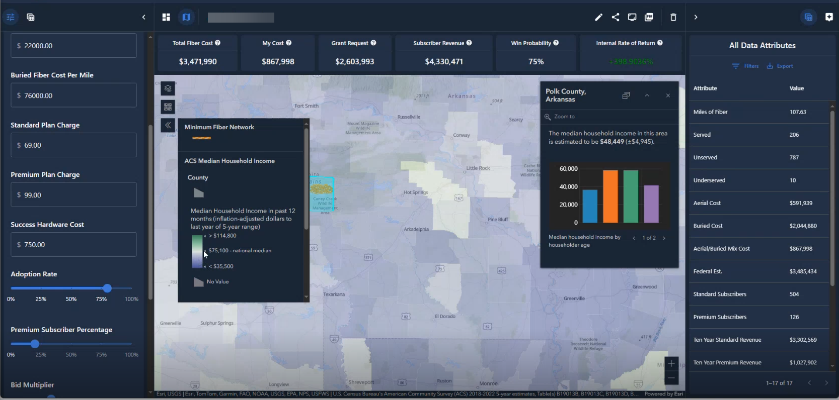
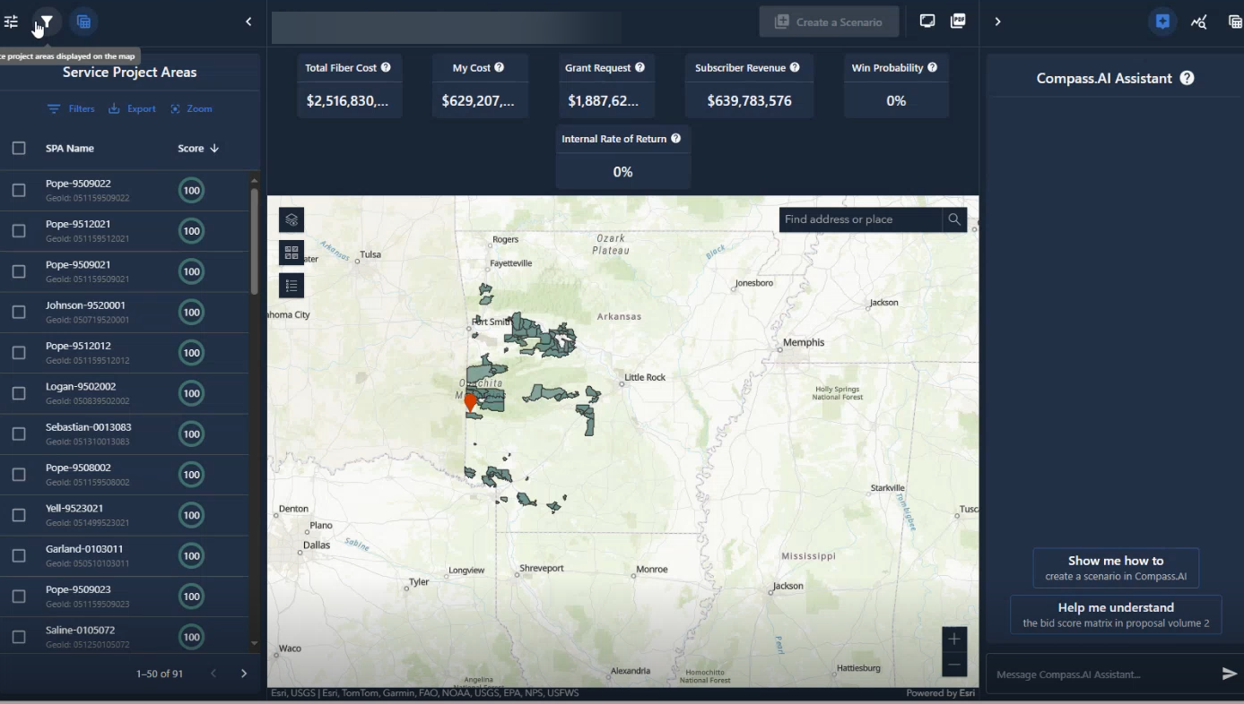
The WHERE
Demographic Overlay of Target Area
Matches Based on Selections
Ability to Alter Custom Business Attributes
Ranking Score
Notes:
Common Business Attributes:
Percentage mix of Buried / Aerial Fiber
Cost per mile for Buried & Aerial Fiber
Take rate for new subscribers
Match percentage
With this information, we can provide service projection areas, total fiber cost (cable + installation), estimated subscriber revenue, and win probability.

Slide 28
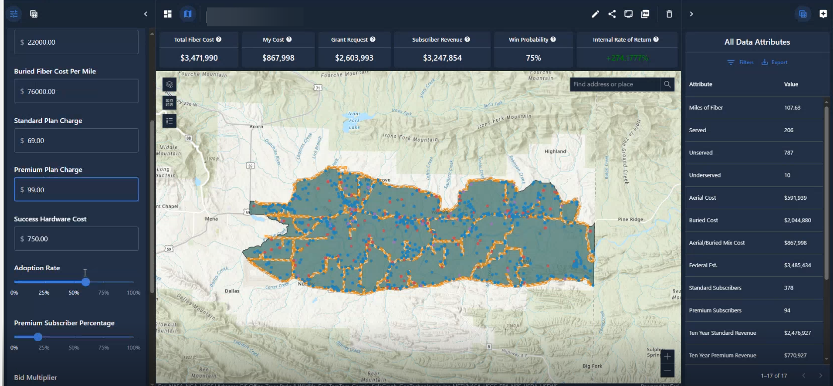
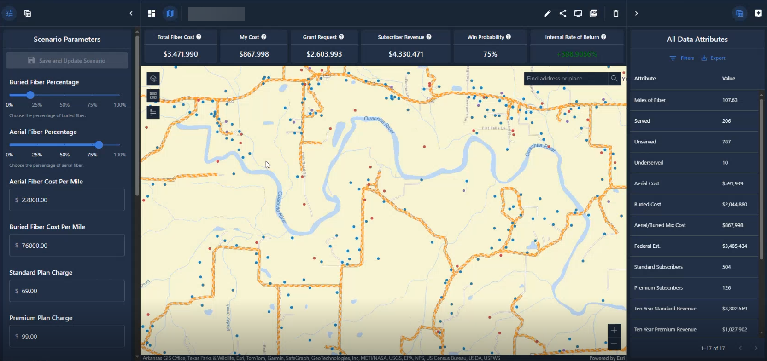
The NETWORK
Recommended Fiber Spine
Matches Based on Selections
Details of Served vs Unserved and Types
Notes:
Based on the latest costquest tier D license, we can plot out your network with rooftop accuracy and determine unserved and underserved households. Based on the location of these households, we then use a AI driven tool to determine the most optimal path for your new fiber network.
The fiber spine is customizable.
This also can be used to identify host cost areas where FWA makes the most sense.

Slide 29
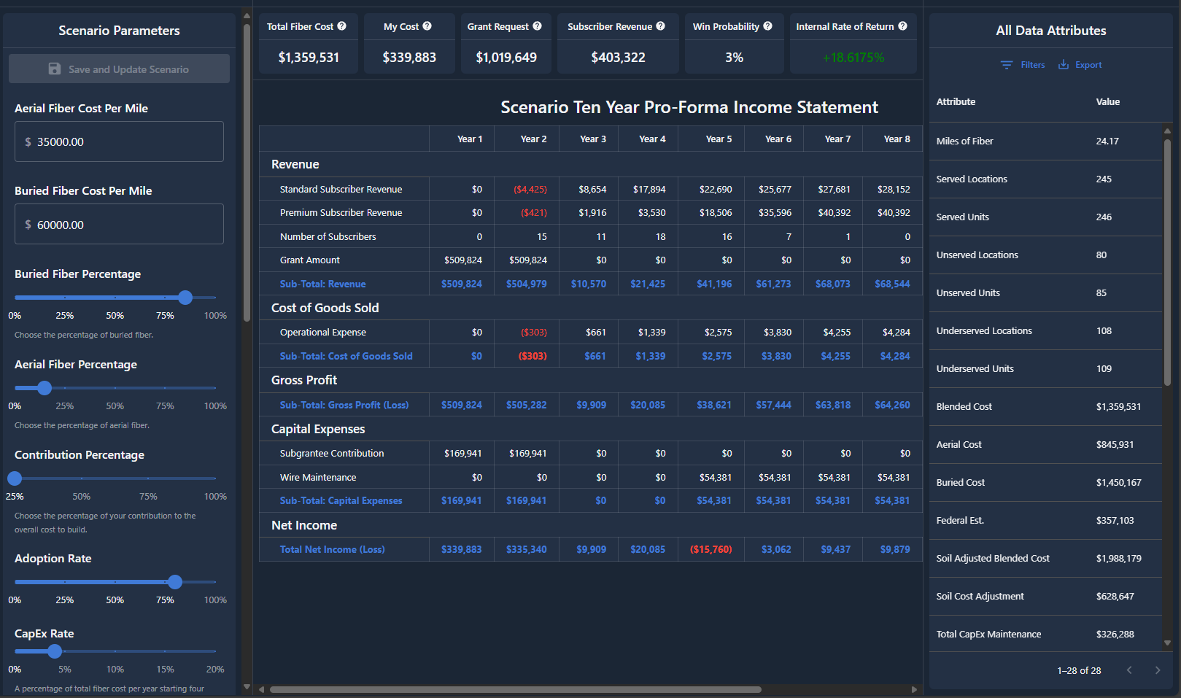
The MONEY (Pro Forma)
Notes:
Through this program, we can also see your network analytics.
Things like:
Total fiber cost, Grant Request, Subscriber Revenue, Win Probability, Rate of return,
10 year pro-forma income statement
Revenue:
Standard subscriber revenue, premium subscriber revenue, number of subs
Cost of Goods Sold
Operational Expenses
Gross Profit
Capital Expenses
Net Income.

Slide 30
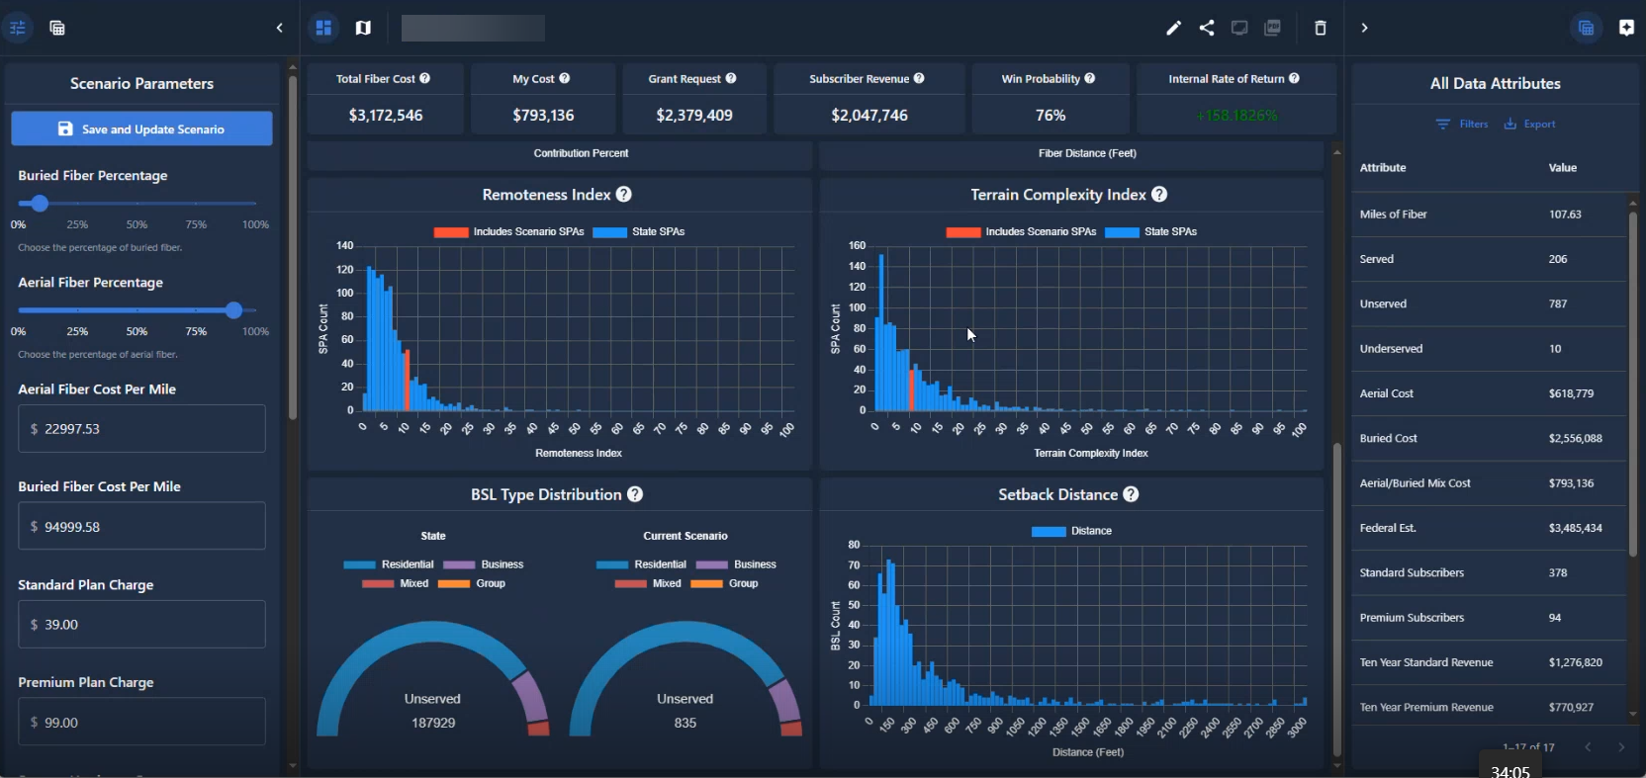
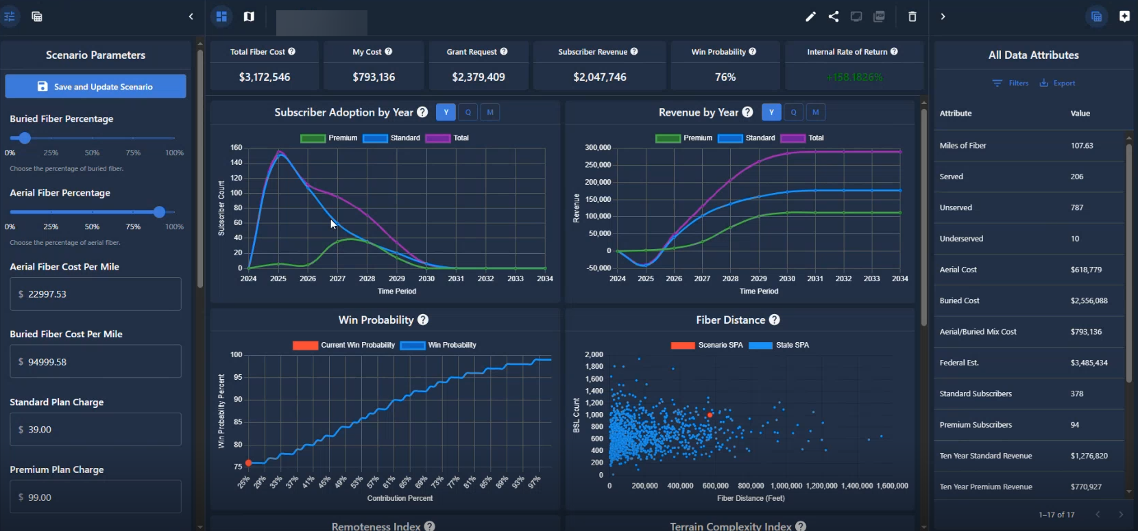
Supporting
Analytics
Notes:
Subscriber adoption by year
Revenue by year
Win probability
Fiber Distance
Remoteness Index
Terrain index

Slide 31
HOW Can We Do This?
Dozens of curated data sources for in-depth cost evaluations and revenue projections including:
    CostQuest Associates Broadband Serviceable Location Fabric dataset
    ESRI’s GIS data
    Population Density, Terrain, and network capacity.
    Costing for buried and aerial fiber installations
Advanced AI analytic engine to optimize data sources for actionable insights.
Intuitive interface for easy navigation.
Powerful visualizations to enable quick decisions.
Create multiple scenarios for comparison and ability to adapt as the landscape changes.

Slide 32
Grant Writing Service

Slide 33

Winncom Grant Writing Services
Document verification
Application writing
Ensuring document compliance
Use-case analysis and technology alignment
Pre-award educational support
Post-award compliance support
Invoice Reimbursement
Compliance Documentation Reporting
Notes:
With our grant writing services, we can collaborate with your engineers to design your project and develop a comprehensive plan of action. Using a high-level design, we will create a detailed project budget that lists everything needed for implementation. This includes the executive summary, project and budget narratives, budget spreadsheets, financial information collection, and digital application submissions.
Additionally, we offer post-award compliance services, which encompass compliance consulting, performance reporting, invoice reimbursement, and closeout reporting.

Slide 34

Notes:
What type of things may be required. This is state dependent. General Expectations.
Audited Financials by independent certified accountant. Last 2-years. Unaudited are acceptable, however they will need them submitted later to receive funding.
Business plans – projections, cash flows
Pro forma
Analysis of current cash flow and balance
3 years of operating costs and cash flow projections.
Resumes – provide you have operation, and technical experience. Org charts. All company and employees. Similar projects requesting 2. Experience can also work.
Network design, diagrams, projects costs, timelines…cert by a professional engineer….
Wages, benefits, contractors /sub-contractors, employee
Letter of support from local gov (every state is different).
BABA Compliance.
Supply chain risk managed / cyber security plan.
Letter of credit (25%) + grant match (25%)

Slide 35
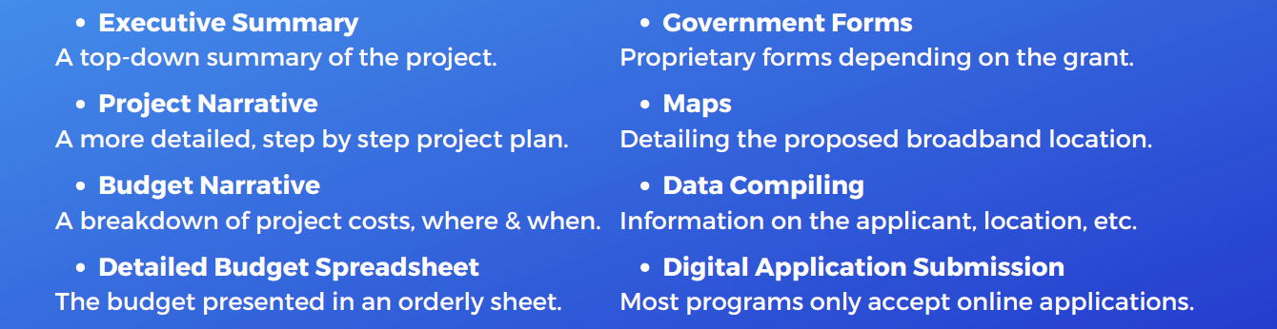
Application Overview
Notes:
Now that you have a location, a basic design, and a budget, you are ready to apply to a grant program. Every state program is different but generally you can expect to provide.,..

Slide 36

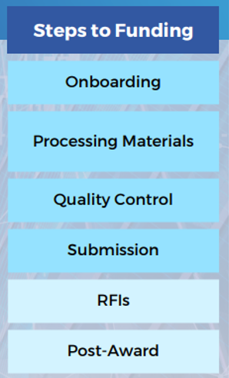
Timeline Estimates
Overall Project Deadlines:
Standard minimal time: 6-8 weeks.
Expedited minimal time: 30-days
Estimated Project Timelines:
Onboarding: 3-5 business days
Processing application materials: 2-6 weeks
Quality control: 1-2 weeks
Application submission: 1-3 days
RFI support: 2-4 weeks (Optional Service)
Post-award compliance services: From 2-3 weeks up to several years (Optional Service)
Notes:
Post support is required. Through our grant writing service, you will have a dedicated contact and a proven workflow that will take you through processing the materials to project reimbursements.

Slide 37

Professional Engineering Services
Onsite Support / PE Stamped Drawings

Slide 38
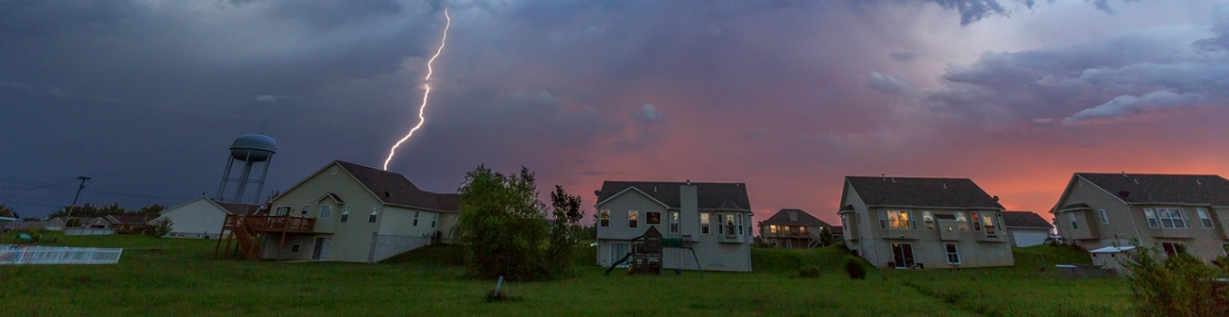
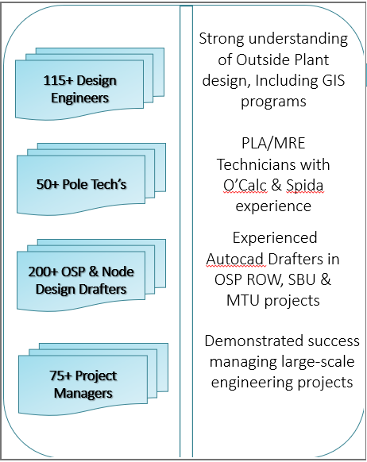



WINNCOM PROFESSIONAL ENGINEERING SERVICE
Winncom Professional Engineering Service
Network Design
&
Optimization
PMO
&
Compliance Services
Broadband & Fiber
Staffing
&
Strategic Consulting
PORTFOLIO OF
In-Building Services
&
Venue Engineering
SERVICES
Network Testing
&
Verification
Site Commissioning
&
Integration
Notes:
In addition to our native technical support capabilities based on the scope of work and size of these opportunities we have extended our staff through strategic partnerships. With our professional engineering services, we have the ability to provide you with a low-level component level fiber design.
Winncom’s Professional Engineering Service develop engineering plans and exhibits using Civil 3D, AutoCAD and GIS formats.
Offer onsite site surveys for wireless and fiber systems and provide PE stamped drawings.
Through our service, we have the ability to manage your OSP construction projects.
Our professional service provider has over 40-years in experience. Typical projects include:
AS-build projects: scope includes locating existing fiber
Relocation Projects: Relocation of existing plant. Scope includes fielding, excavation permits, new design, and traffic control designs.
Network Drop Projects: Field, sesign, engineering, and permit design.
Backhaul Engineering: Full engineering design of fiber runs
FTTE Projects: Field, engineering & permit drawings
FTTH Projects: Scope included the design, engineering (fiber counts and splice types) of fiber runs via Aerial and Underground to homes

Slide 39
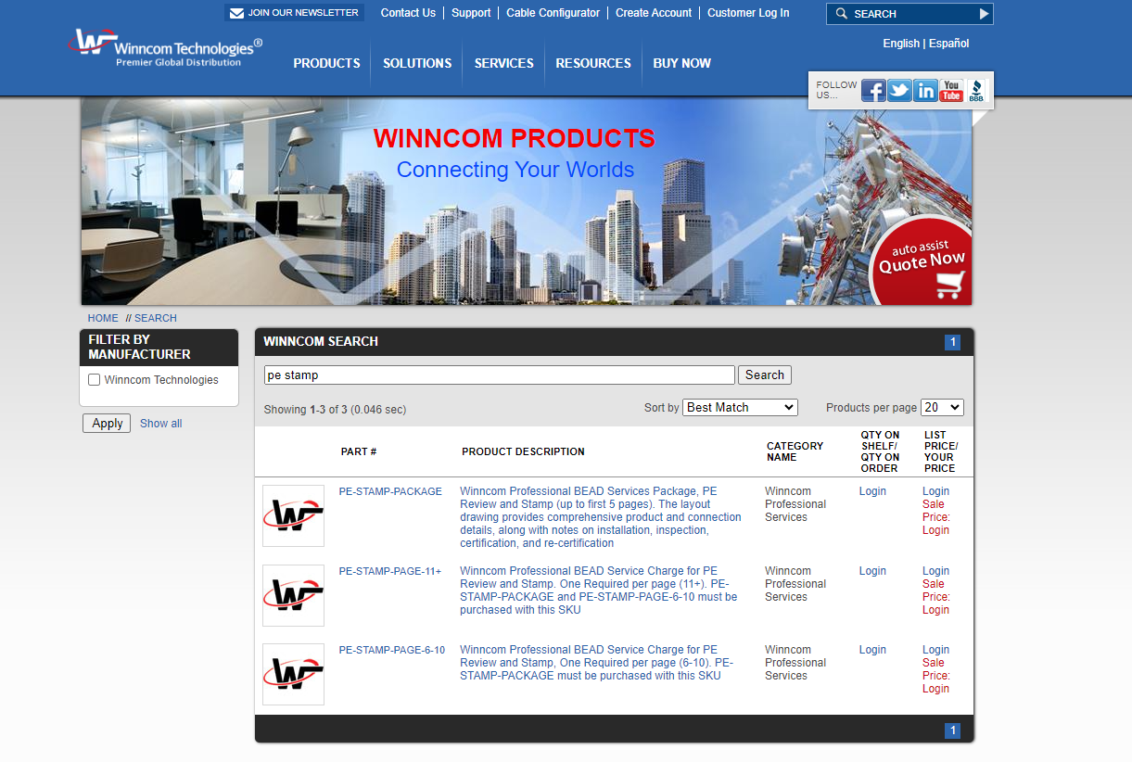

Slide 40

Financing Solutions: Tailored financing options for both services and equipment, enabling project execution without upfront capital constraints.
Comprehensive Support: From project inception to completion, our financial services are designed to empower applicants, ensuring compliance and enhancing project viability.
Notes:
We are partnered with LEAF, a leading provider in tailored financial solutions, specializing in empowering BEAD program participants with essential funding support for services and equipment.
Funding is a potential problem. It is possible to need up to 50% coverage. 25% letter of credit plus 25% grant match
With leaf, we can offer you two different types of options.
Leaf Financial Corporation was formed in 2002. Operating over 22 years, Leaf is also a part of Bank of America.
Capital Now Program. This is a leasing service for nontangible products like grant writing and professional engineering. Like working capital, this short-term financing options provides up to 300K in funds financed over a 3–24-month term. 25,000 minimum to $300,000 maximum
Equipment Financing Options. Reduce your grant match obligation by prepaying for equipment. This is leafs bread and butter. Longer term financing. UP to 1-5 years. Preapprovals available up to 500k.

Slide 41

Winncom BEAD Portal

Slide 42
Action Items:
Schedule a consultation to strategize on positioning your company for a successful BEAD application in your state
Schedule a call to learn more about Winncom BEAD Programs
Contact Information
Winncom Bead Consultation: bead@winncom.com
Winncom BEAD Portal
Registration Link: www.winncomus.com/bead/

Slide 43


